Slide 1
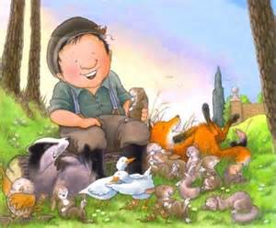
Geography
In class, we will look at naming and locating the 4 countries of UK on map and in atlases. Linked with science, we will identify seasonal weather patterns and discuss hibernation. In our outdoor classroom we will use 4 compass directions and discuss, weather, seasons and name some features we see. We will also look at maps of further afield to make comparisons
Science
The children will identify and compare basic animals from the various stories shared in class.
We will also observe seasonal changes, looking at weather/ daylight etc
Literacy-we will be looking at a range of:
Stories with Familiar settings
We will look at a wide range of stories by Nick Butterworth to help us set up our new role play area and inform many other areas of our curriculum. In the coming weeks, the children will look at -Poetry with pattern and rhyme
to describe Winter and Christmas
The children will also have the opportunity to write Thankyou notes and cards to Percy and the animals
Percy the Park-keeper Autumn term 2 2014
Physical Education-the unit of work is gymnastics and will be taught this half term on Tuesday and Thursday. We will learn about using apparatus safely and about different ways of moving and landing on the mats.
PSHE-this half term will
focus on
getting on & falling out and we will also be running various activities during Anti-bullying week (17th-21st November)-further information will be provided about this
Design and Technology
>Help Percy to design a functional home for animal needing to hibernate
>Design and make a Christmas bauble for tree/ Sew buttons/sequins onto fabric tree to decorate and use as Christmas card.
Numeracy- the children will have lots of hands on, practical opportunities to work on sequencing and sorting numbers, shapes and objects. We will be looking at starting points with fractions to see a whole, a half and a quarter, measure lots of containers to check their capacity and volume. There will be opportunities to use money in a range of different contexts within the classroom and we will look at aspects of time to check what day and time the park or the shop is open
Religious Education-we will be looking at Christianity and some of the important things in a Christian’s life. Pupils will also have the opportunity to become familiar with aspects of the Christmas story as rehearsals go underway for our Christmas production in the coming weeks
Computing
The children will recreate sounds of animals and record these on the various resources in school, such as-Easi- speak or sound button on Fronter. They will share sounds and explain to others how they were created
E-safety online research
We will talk about the importance of e-safety with the children

