Slide 1
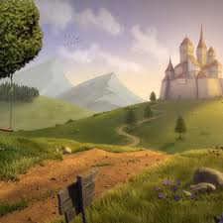
Literacy
We will look at traditional stories, along with letters-linking all of this to the various characters we will look at. There will be opportunities to utilise ICT skills for typing up elements of a story and for writing their own versions.
Numeracy-we will follow the National Strategy and focus particularly on recognising and ordering numbers, bigger and smaller and various language used throughout the numeracy curriculum.
Role play
Our main role play will be a fairy-tale cottage. This will be enhanced as we look at each new story to support learning through play and to embed the stories we have been looking at.
Science
The children will investigate suitable materials for different purposes and enjoy opportunities to build the 3 Pigs’ Houses. We will look at changing state when baking gingerbread men and be led by the children’s ideas for any further scientific investigation.
Once Upon A Time
RE and PSHE
We will be looking at various elements of the stories to link with how we are all special and how we can after each other and the things around us.
Design technology and creative art
The children will use paint and other media to create various images, along with access to ICT to create art work. Split pin characters and masks will link with moving pictures and baking opportunities will be utilised throughout the theme.

